Slide 1
Segment Override
MOV CX , SS: [BX]
Here, the concept of Segment Override Prefix is being used. Although the default segment for the offset BX is DS, as the SS is mentioned in the instruction, it is overriding the default segment. Hence, the Stack Segment (SS) register is being used here.

Slide 2
Chapter 5 8086 Microprocessor Instruction Set

Slide 3
8086 - Instruction Set
Classification of Instruction Set
Data Transfer Instructions
Arithmetic Instructions
Bit Manipulation Instructions
String Instructions
Program Execution Transfer Instructions
Processor Control Instructions

Slide 4
8086
Instruction Set
Data Transfer Group
Arithmetic Group
Program Transfer Instructions
Bit manipulation
String Instructions
Process Control Instructions
Unconditional
Conditional
Iteration Control
Interrupt Instructions
General Purpose (05)
Input/ Output (02)
Address Object (03)
Flag Transfer (04)
Addition (05)
Subtraction (07)
Multiplication (03)
Division (05)
Flag Opeartion (07)
External Synchronisation (04)
No Opeartions (01)
Logical (05)
Shift (03)
Rotate (04)

Slide 5
8086 - Instruction Set
Data Transfer Instructions
These instructions are used to transfer data from source to destination.
The operand can be a constant, memory location, register or I/O port address.

Slide 6
8086 - Instruction Set-Data Transfer Instructions
General purpose
MOV | :Move byte or word
PUSH | : Push word onto stack
POP | : Pop word off stack
XCHG | : Exchange byte or word
XLAT | : Translate byte
Input/ Output
IN | : Input byte or word
OUT | : Output byte or word
Address Object
LEA | :Load effective address
LDS | :Load pointer using DS
LES | : Load pointer using ES
Flag Transfer
LAHF | : Load AH register from flags
SAHF | :Store AH register in flags
PUSHF | :Push flag onto stack
POPF | :pop flags off stack

Slide 7
8086 - Instruction Set
General Purpose Byte or Word Transfer Instruction
1. MOV : copy a Word or a Byte
MOV destination, source: destination source
MOV operand 1, operand 2: operand 1 operand 2
Sr.No | Destination | Source
1 | Memory | Accumulator
2 | Accumulator | Memory
3 | Register | Register
4 | Register | Memory
5 | Memory | Register
Sr.No | Destination | Source
6 | Register | Immediate
7 | Memory | Immediate
8 | Seg – Reg | Reg – 16
9 | Seg – Reg | Mem - 16
10 | Reg – 16 | Seg – Reg
11 | Mem - 16 | Seg – Reg

Slide 8
8086 - Instruction Set
General Purpose Byte or Word Transfer Instruction
MOV memory, accumulator:
Copies the contents of accumulator to memory location specified in the instruction.
E.g.: MOV [SI], AL
MOV accumulator, memory:
Copies the contents of memory location specified in the instruction to accumulator
E.g.: MOV AX, TEMP_RESULT; TEMP_RESULT Memory location

Slide 9
8086 - Instruction Set
General Purpose Byte or Word Transfer Instruction
MOV memory, accumulator:
Copies the contents of accumulator to memory location specified in the instruction.
E.g.: MOV [SI], AX if SI = 2013, CS= 4205, IP = 187A, DS =2314, AX= 4220
AX | MSB | LSB
BX
CX
DX
SI | 2013
DI
BP
SP
LSB
MSB
Physical Address =
2 3 1 4 0 H → contents of DS
+ 2 0 1 3 H → offset in SI
2 5 1 5 3 H → PA of mem location
2013
2013+1

Slide 10
8086 - Instruction Set
E.g.: MOV [SI], AX if SI = 2013, CS= 4205, IP = 187A, DS =2314, AX= 4220
Physical Address =
2 3 1 4 0 H → contents of DS
+ 2 0 1 3 H → offset in SI
2 5 1 5 3 H → PA of mem location
 | Before Execution | After Execution
Code Segment (CS) | 2105H | 2105H
Instruction Pointer (IP) | 187AH | 187CH
Data Segment (DS) | 2314H | 2314H
Register AL | 20H | 20H
Mem Location-24163H | FFH | 20H

Slide 11
8086 - Instruction Set
General Purpose Byte or Word Transfer Instruction
MOV destination reg, source reg:
Copies the contents of source reg. to the destination reg.
E.g.: MOV AX, BX
MOV register, memory:
Copies the contents of memory location specified in the instruction to register
E.g.: MOV CX, COUNT [DI]; COUNT is a variable defined while programming Memory location

Slide 12
8086 - Instruction Set
General Purpose Byte or Word Transfer Instruction
MOV memory , register:
Copies the contents of the source register to the specified memory location in the instruction.
This can be 8/16 bit transfer.
Cannot be used to access the value of CS & IP.
E.g.: MOV COUNT [DI], CX

Slide 13
8086 - Instruction Set
General Purpose Byte or Word Transfer Instruction
MOV register, immediate:
Copies the immediate data to the destination reg.
E.g.: MOV CL, 02H
MOV memory , immediate :
Copies the immediate data to the memory location specified in the instruction.
E.g.: MOV COUNT [DI], 2D H; COUNT is a variable defined while programming Memory location

Slide 14
8086 - Instruction Set
General Purpose Byte or Word Transfer Instruction
MOV seg. reg., reg-16:
Copies the 16-bit source register contents to the destination segment segment register.
It cannot be used to copy the contents of CS reg
Only 16 bit transfer. 8 bit iilegal
E.g.: MOV DS, AX

Slide 15
8086 - Instruction Set
General Purpose Byte or Word Transfer Instruction
MOV seg. reg., mem-16:
Copies the contents of specified memory location into the desired segment register.
E.g.: MOV DS,[SI]
MOV reg-16, seg. reg. :
Copies the contents of 16 bit segment register into the destination register specified in the instruction.
E.g.: MOV AX, DS

Slide 16
8086 - Instruction Set
2. PUSH Operand: Push Word onto Stack
It pushes the operand into top of stack.
This instruction decrements the stack pointer by 2 & copies a word from a specified source to the location in the stack segment where the stack pointer points
The source of the operand:
general purpose reg,
segment reg,
flag reg or
memory
The stack segment reg and stack pointer must be initialised before using this instruction.
E.g.: PUSH BX; SS:[SP-1] BH, SS:[SP-2] BL, SP [SP-2]

Slide 17
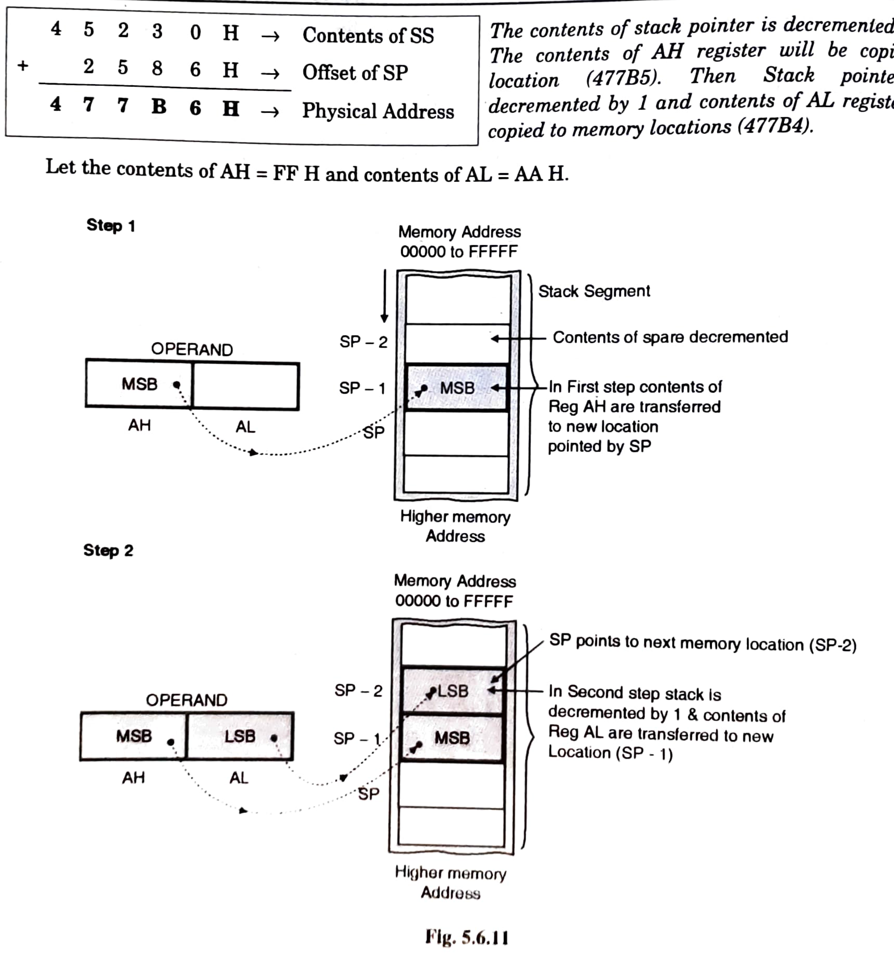
PUSH AX
If SS = 4523H; SP = 2586H; CS = 2105H; IP = 187AH

Slide 18
8086 - Instruction Set
3. POP Des: Pop Word off Stack
It pops the operand from top of stack to Des.
Des can be a general purpose register, segment register (except CS) or memory location.
E.g.: POP AX; AL SS:[SP], AH SS:[SP+1]
SP [SP+2]
Physical Address =
4 5 2 3 0 H → contents of SS
+ 2 5 8 6 H → offset in SI
4 7 7 B 6 H → PA Top of Stack
If SS = 4523H; Offset of SP = 2586H; CS = 2105H and IP = 187AH
Contents of 477B6 = 3BH and 477B7 = 2AH

Slide 19
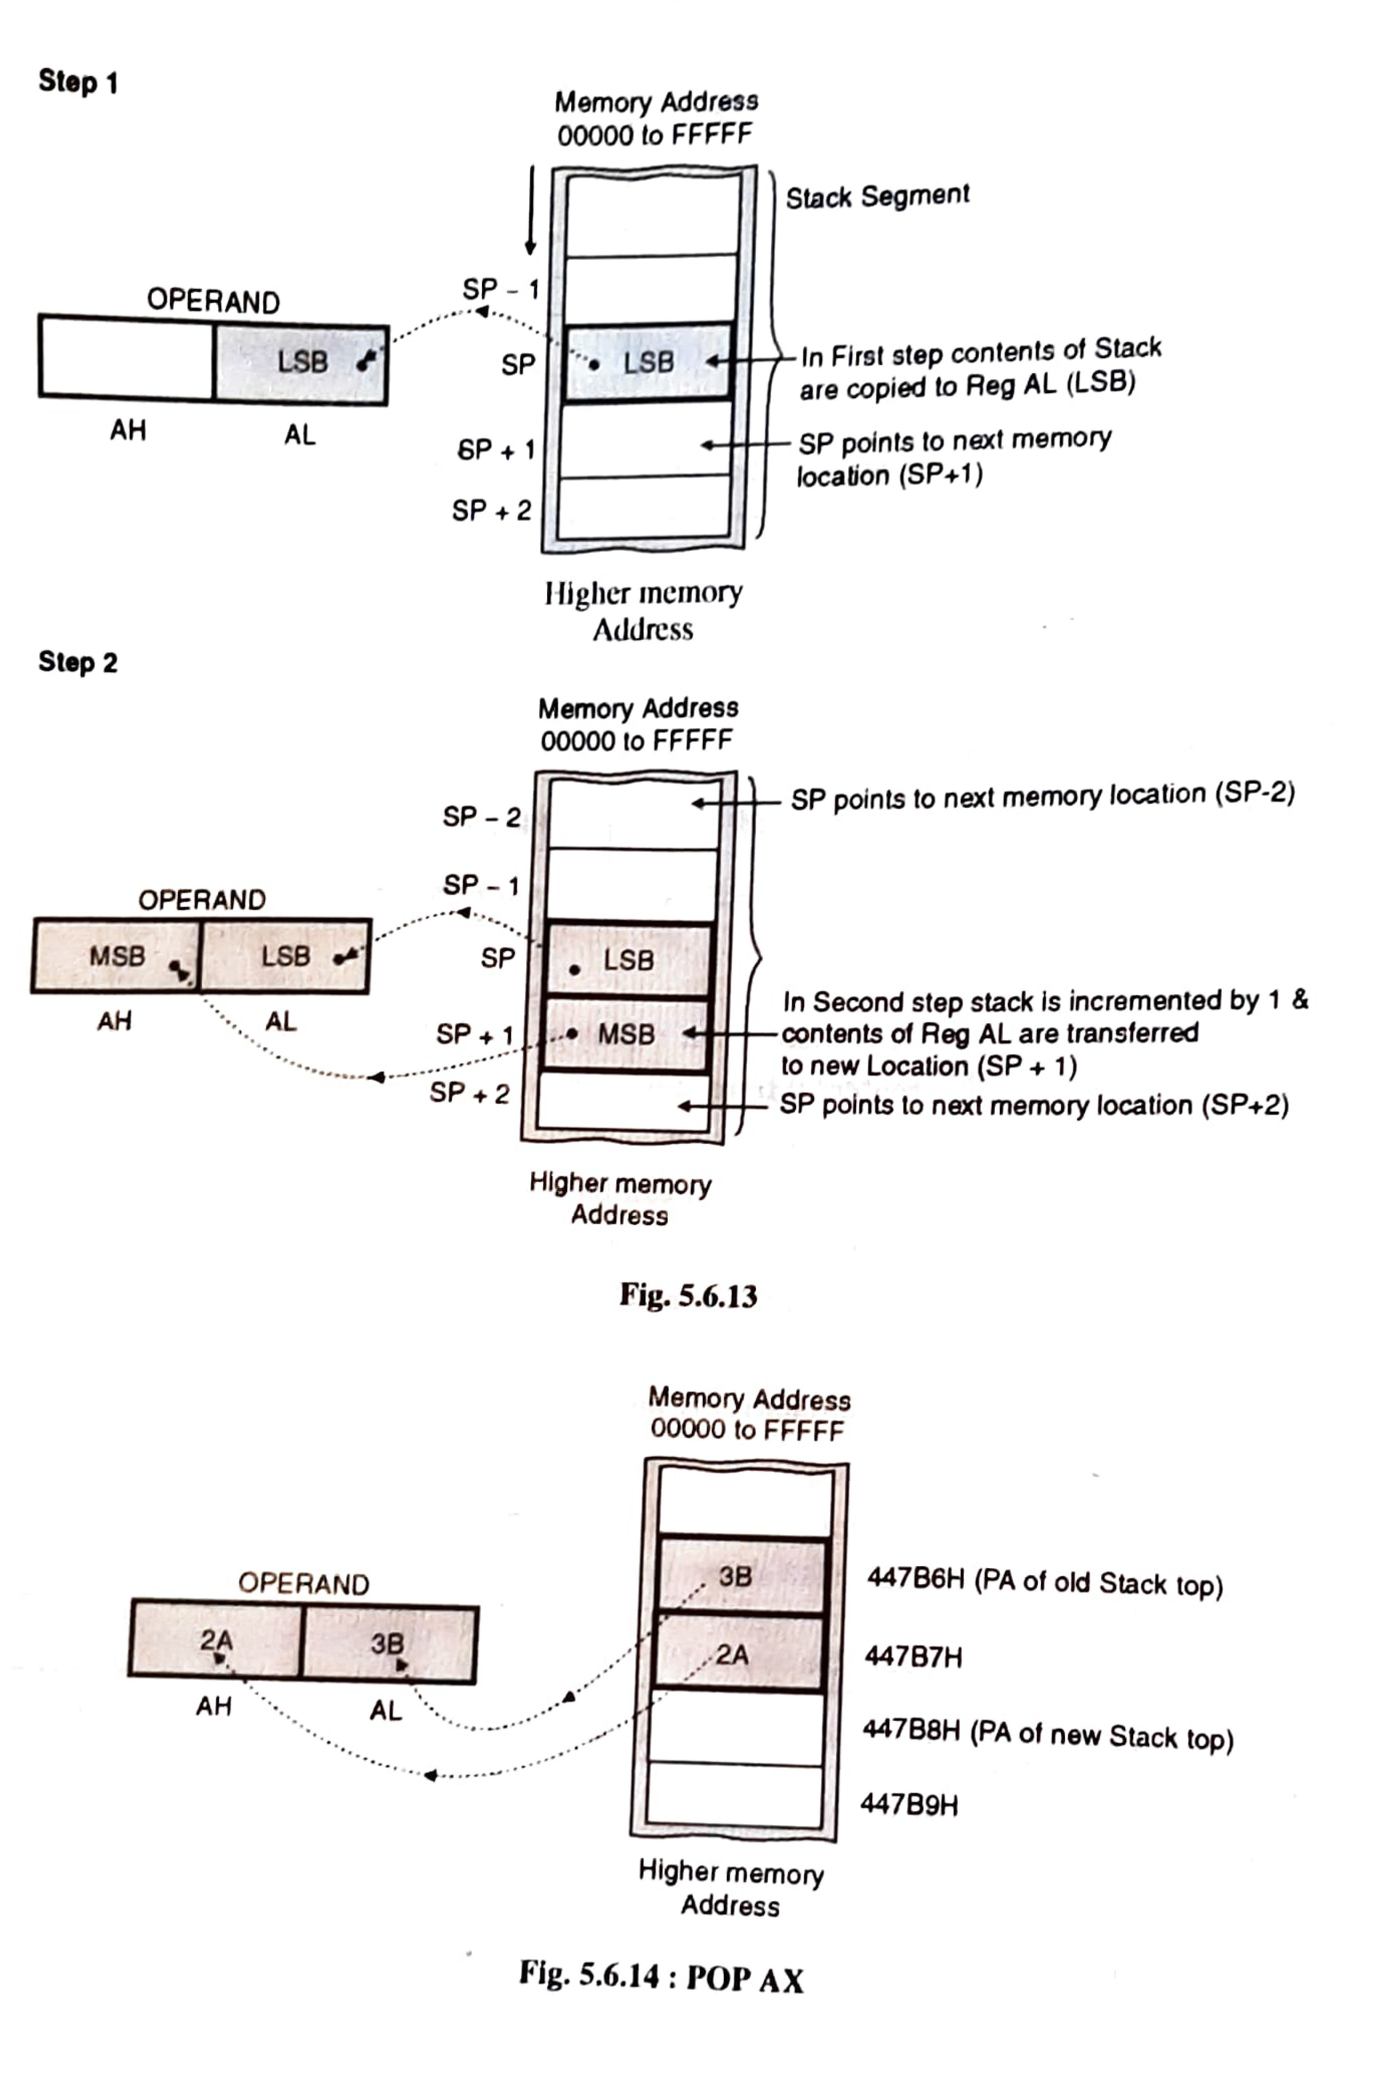
If SS = 4523H; Offset of SP = 2586H; CS = 2105H and IP = 187AH
Contents of 477B6 = 3BH and 477B7 = 2AH
Physical Address =
4 5 2 3 0 H → contents of SS
+ 2 5 8 6 H → offset in SI
4 7 7 B 6 H → PA Top of Stack

Slide 20
8086 - Instruction Set
XCHG Des, Src: Exchange byte or word
This instruction exchanges Src with Des.
Src: Register, Memory Location
Des: Register, Memory Location
It cannot exchange two memory locations directly.
E.g.: XCHG DX, AX ; DX AX
Segment reg. cannot be used as reg

Slide 21
8086 - Instruction Set
XLAT: Translate or Replace byte
XLAT/ XLATB
AL = DS:[BX+ unsigned AL]
This instruction replaces a byte in AL register with a byte from a look up table in the memory i.e it copies the value of memory byte at location DS : [BX + unsigned AL]
Here the contents of AL acts as index to the desired location in lookup table
Segment reg. cannot be used as reg

Slide 22
8086 - Instruction Set
XLAT
Translate byte in AL reg with a byte from a lookup table in memory.
BX stores the offfset of the starting address of the lookup table
AL reg stores the byte no. from the lookup table.
This instruction copies byte from address ponted by [BX+AL] back into AL or Move into AL the contents of memory location in Data Segment, whose offset address is formed by [BX+AL]

Slide 23
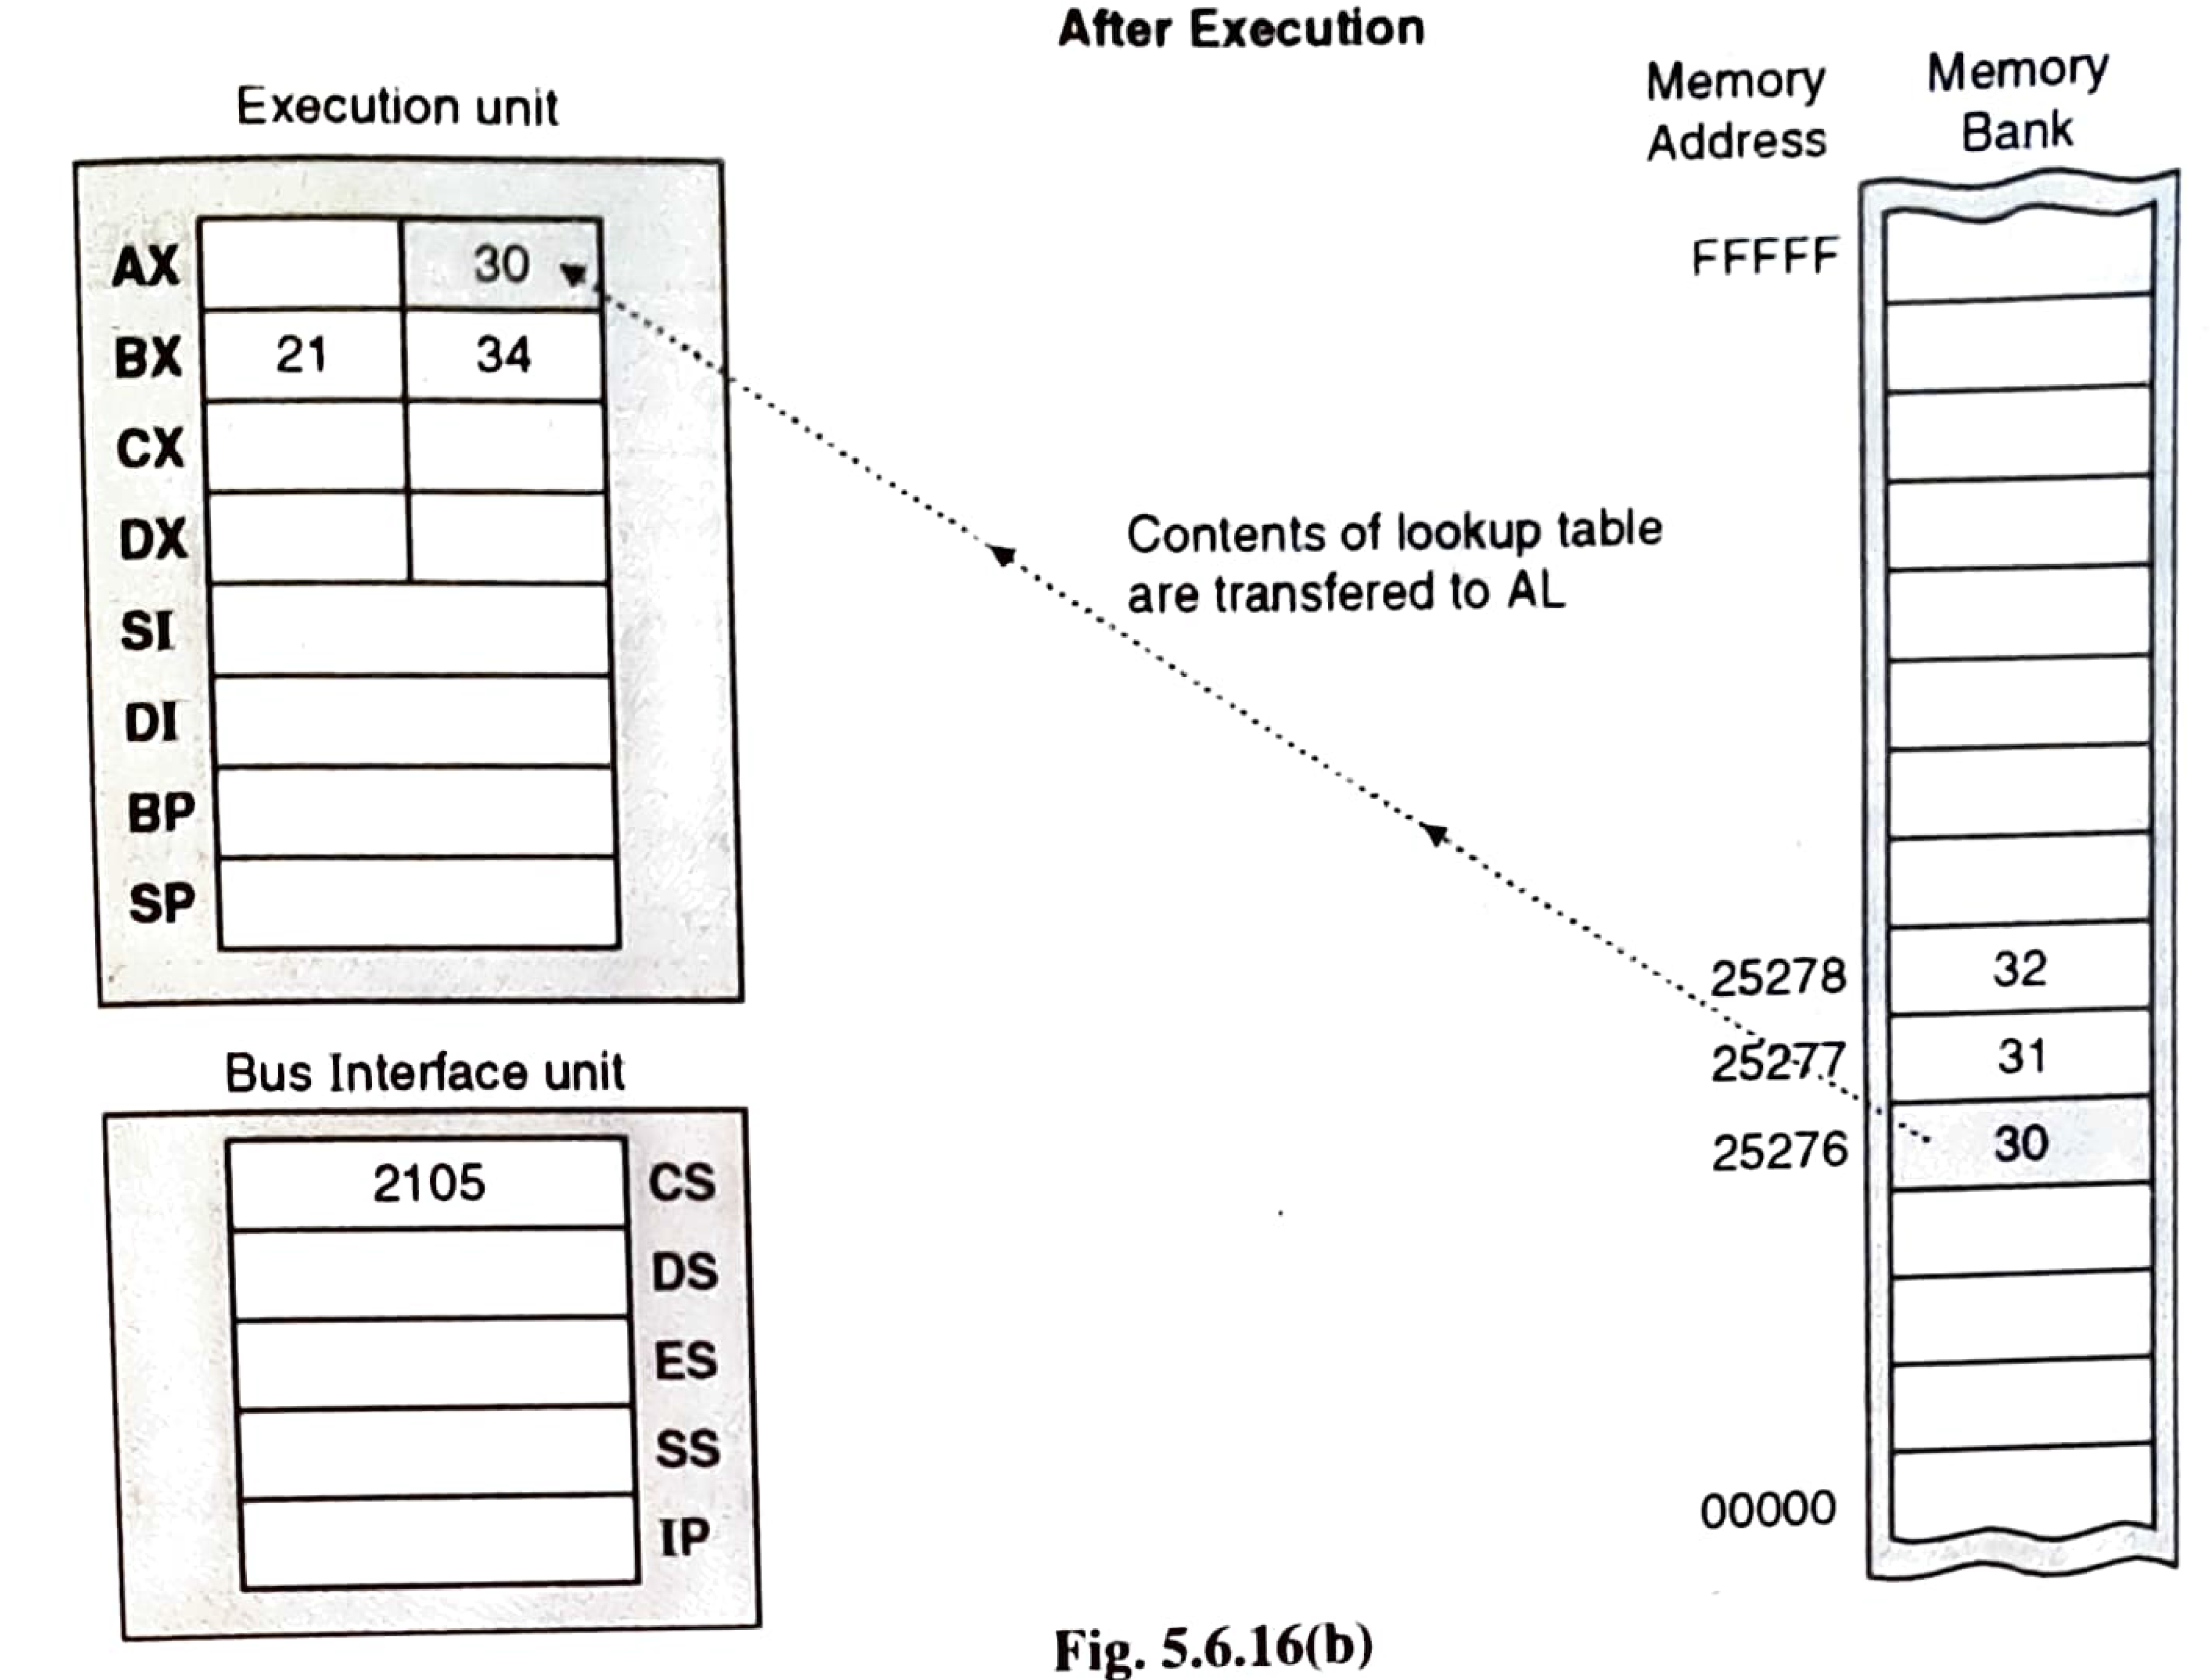
AL = DS:[BX+ unsigned AL]

Slide 24
8086 - Instruction Set
Input/ Output
These instructions are basically related to communication with I/O devices.
2 instructions: IN & OUT

Slide 25
8086 - Instruction Set
6.1. IN Accumulator, Port Address
It transfers the operand from specified port to accumulator register.
E.g.: IN AX, 28 H; AX [28H]_{I/O}
6.2. OUT Port Address, Accumulator:
It transfers the operand from accumulator to specified port.
E.g.: OUT 28 H, AX; [28H]_{I/O} AX
Port can be a 8 bit or 16 bit port.

Slide 26
8086 - Instruction Set
Address Object
These instructions manipulate the addresses of the variables, rather than the contents or values of the variables.
These are mainly used for list processing, based variables and string operation.
3types:
LEA: Load Effective Address
LDS: Load pointer with DS
LES: Load pointer using ES

Slide 27
8086 - Instruction Set
7.1 LEA Register, Src:
Load Effective Address.(offset addr.)
It loads a 16-bit register with the offset address of the data specified by the Src.
The offset is loaded into index reg. or base pointer reg- SI,DI,BX,BP
E.g.: LEA AX, COUNT
This instruction loads AX with the offset of COUNT in DS.
AX offset of COUNT

Slide 28
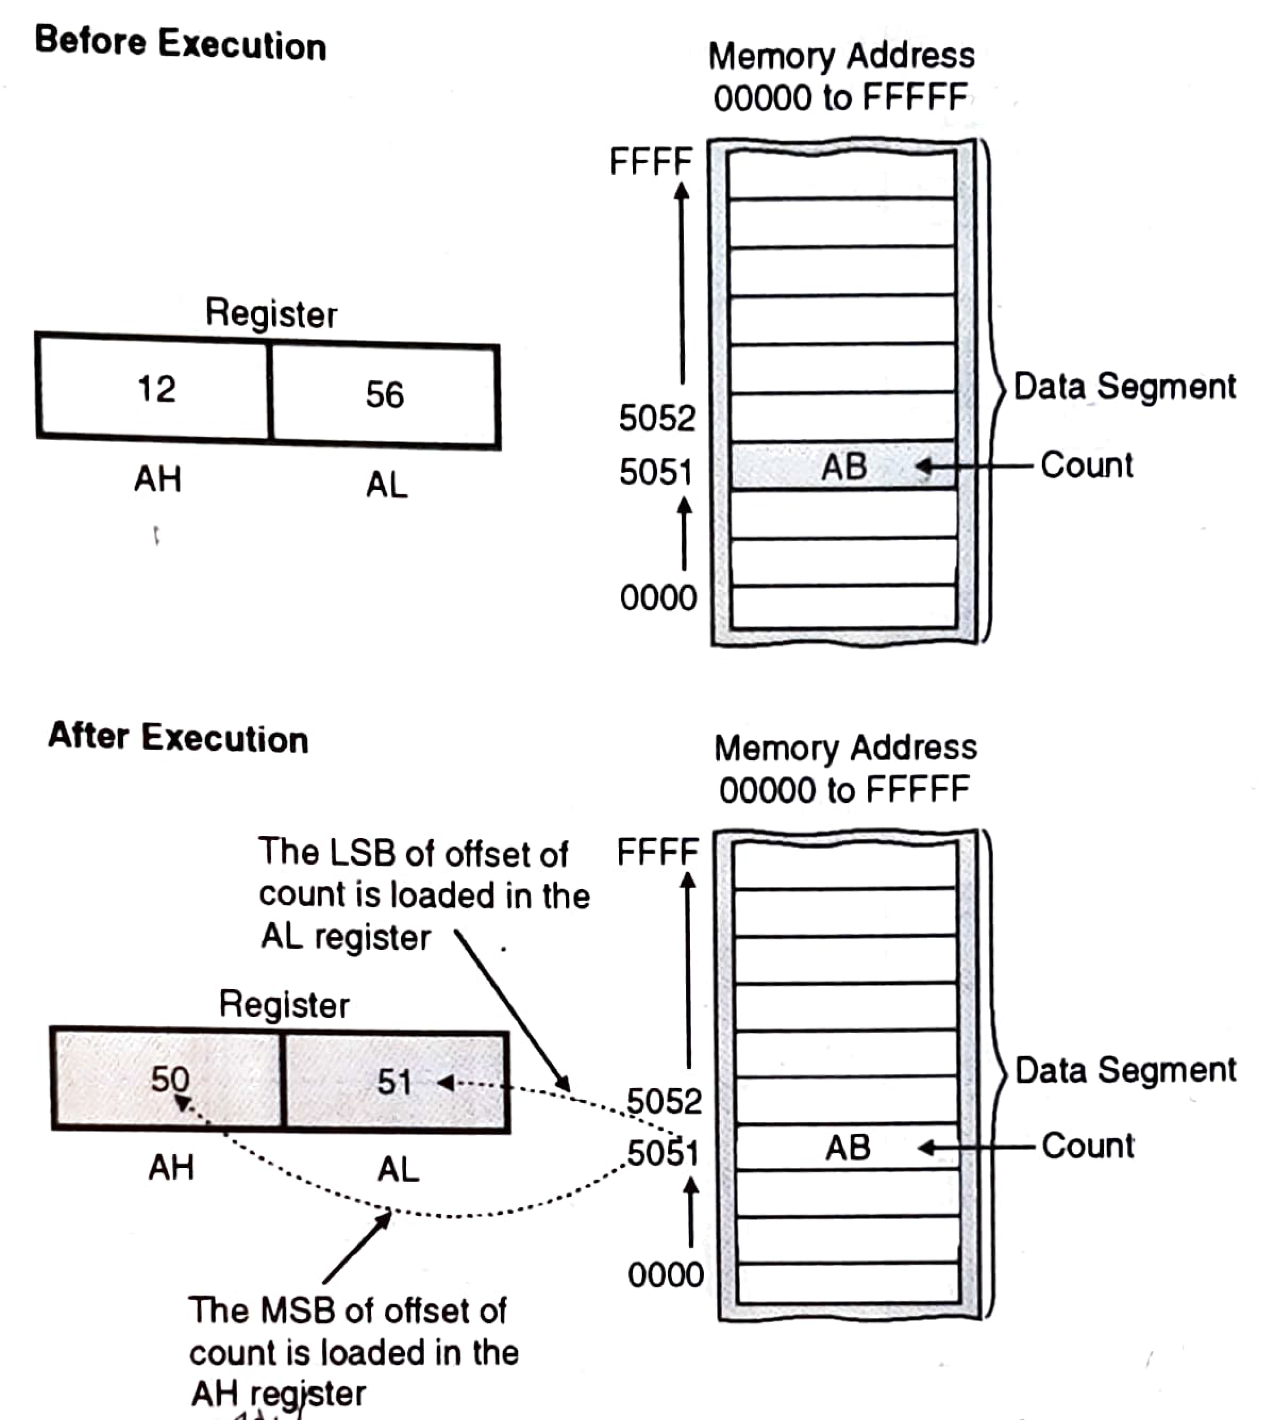
LEA AX, count
If Count = 5051

Slide 29
8086 - Instruction Set
7.2. LDS reg, Src: Load pointer with DS
The source is always memory location & DS is used as segment reg for memory.
It is a 2 byte instruction.
It copies a word from 2 memory locations into reg specified in the instruction.
It copies a word from the next 2 memory locations into DS reg
It loads 32-bit pointer from memory source to destination register and DS.

Slide 30
8086 - Instruction Set
7.2. LDS reg, Src: Load pointer with DS
The offset addr. is placed in the destination register and the segment addr. is placed in DS.
To use this instruction the word at the lower memory address must contain the offset addr and the word at the higher address must contain the segment addr.
E.g.: LDS BX, [0301 H]
BX {DS:[0301H], DS:[0301H +1]}
DS {DS:[0301H+2], DS:[0301H +3]}

Slide 31
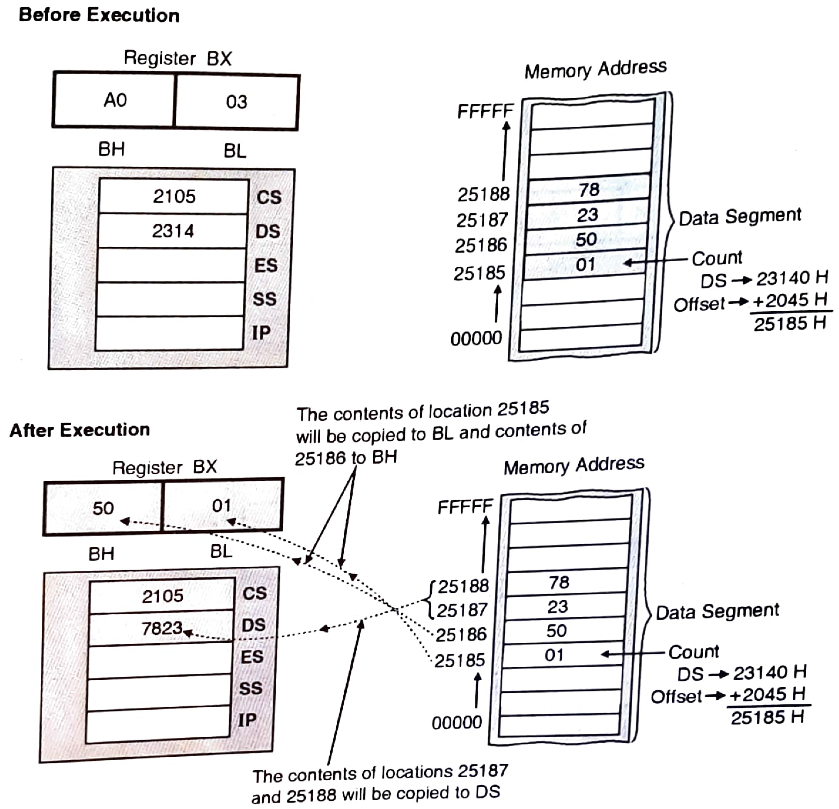
LDS BX, count
Count = 2045
DS = 2314; CS = 2105H and IP = 187AH; ES = 2010H
Physical Address
2 3 1 4 0 H
+ 2 0 4 5 H
2 5 1 8 5 H

Slide 32
8086 - Instruction Set
7.3. LES reg, Src: Load pointer using ES
The source is always memory location.
It is a 2 byte instruction.
It copies a word from 2 memory locations into reg specified in the instruction.
It copies a word from the next 2 memory locations into ES reg
It loads 32-bit pointer from memory source to destination register and ES.

Slide 33
8086 - Instruction Set
7.3. LES reg, Src: Load pointer using ES
The offset addr. is placed in the destination register and the segment addr is placed in ES.
This instruction is very similar to LDS except that it initializes ES instead of DS.
E.g.: LES BX, [0301 H]
BX {DS:[0301H], DS:[0301H +1]}
ES {DS:[0301H+2], DS:[0301H +3]}

Slide 34
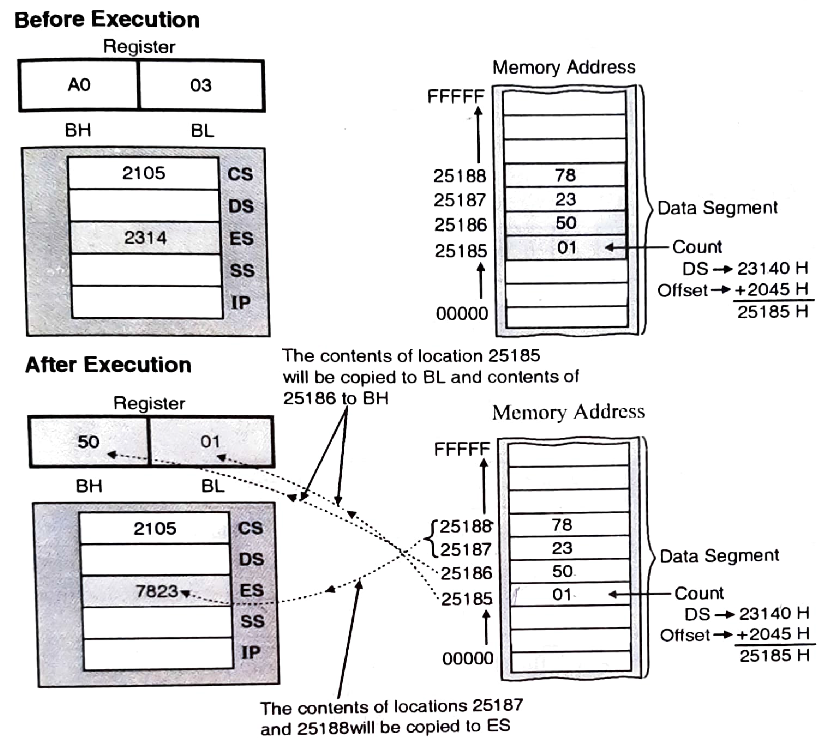
LES BX, count
Count = 2045
ES = 2314; CS = 2105H and IP = 187AH; DS = 2010H; BH = A0H; BL = 03H
Physical Address
2 3 1 4 0 H
+ 2 0 4 5 H
2 5 1 8 5 H

Slide 35
8086 - Instruction Set
Flag Instructions
These instructions are related to movement of flag register to/from a register & memory
4 instructions:
LAHF
SAHF
PUSHF
POPF

Slide 36
8086 - Instruction Set
8.1. LAHF
The lower byte of flag register is copied to the AH reg.
AH | AL |  | X | X | X | X | OF | DF | IF | TF | SF | ZF |  | X | AC | X | PF | X | CF
A0 | 03 |  | 0 | 0 | 0 | 0 | 1 | 1 | 0 | 0 | 1 | 1 |  | 0 | 0 | 0 | 1 | 1 | 0
 |  |  | MSB OF FLAG REG.= OCH |  |  |  |  |  |  |  | LSB OF FLAG REG.= C6H
C6 | 03 |  | 0 | 0 | 0 | 0 | 1 | 1 | 0 | 0 | 1 |  | 1 | 0 | 0 | 0 | 1 | 1 | 0

Slide 37
8086 - Instruction Set
8.2. SAHF
It stores the contents of AH to lower byte of flag register.
AH | AL |  | X | X | X | X | OF | DF | IF | TF | SF | ZF |  | X | AC | X | PF | X | CF
A0 | 03 |  | 0 | 0 | 0 | 0 | 1 | 1 | 0 | 0 | 1 | 1 |  | 0 | 0 | 0 | 1 | 1 | 0
 |  |  | MSB OF FLAG REG.= OCH |  |  |  |  |  |  |  | LSB OF FLAG REG.= C6H
A0 | 03 |  | 0 | 0 | 0 | 0 | 1 | 1 | 0 | 0 | 1 |  | 0 | 1 | 0 | 0 | 0 | 0 | 0
 |  |  | MSB OF FLAG REG.= OCH |  |  |  |  |  |  |  | LSB OF FLAG REG.= A0

Slide 38
8086 - Instruction Set
8.3 PUSHF: Push flags onto stack
Pushes flag register to top of stack.
This instruction decrements the stack pointer by 2
Copies word in the flag reg to the memory location pointed by stack pointer
SS:[SP-1] Flag_{H}, SS:[SP-2] Flag_{L}, SP SP-2

Slide 39
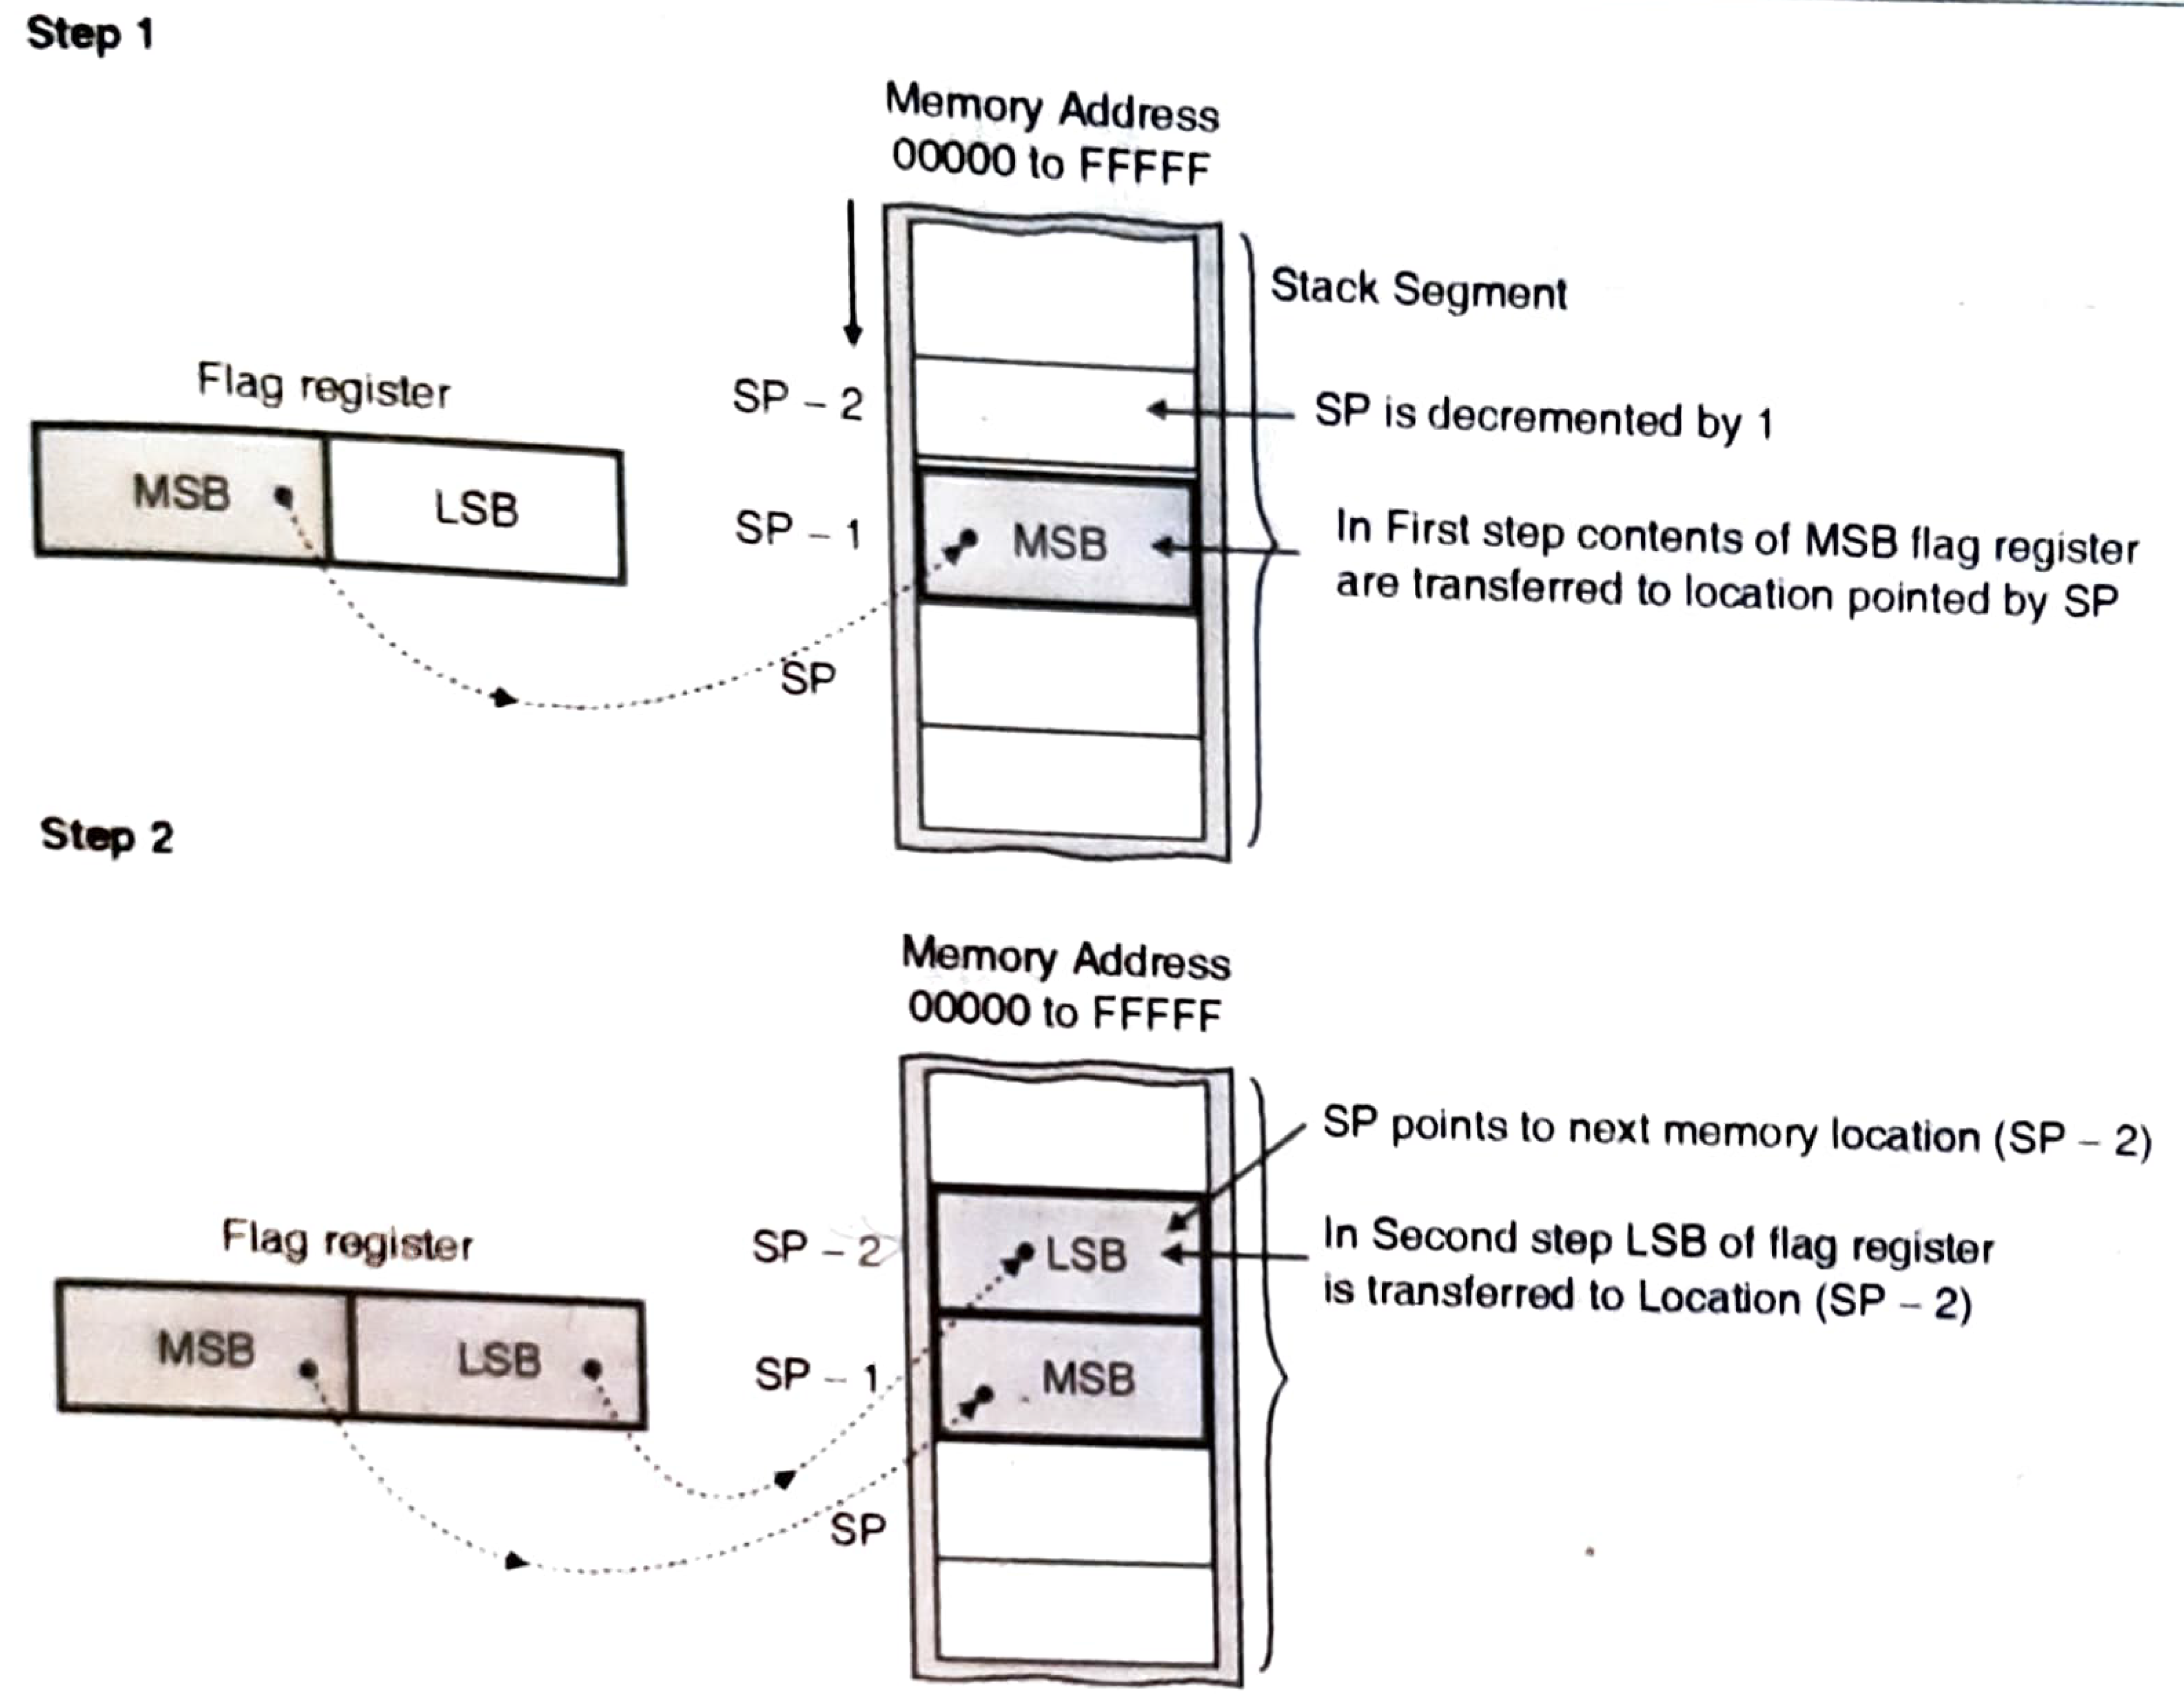
PUSHF

Slide 40
8086 - Instruction Set
8.4 POPF : Pop flags off stack
Pops the stack top to flag register.
This instruction copies a word from the 2 memory locations at the top of the stack to the flag register.
it increments the stack pointer by 2
Flag_{H} SS:[SP], Flag_{L} SS:[SP+1], SP SP+2

Slide 41
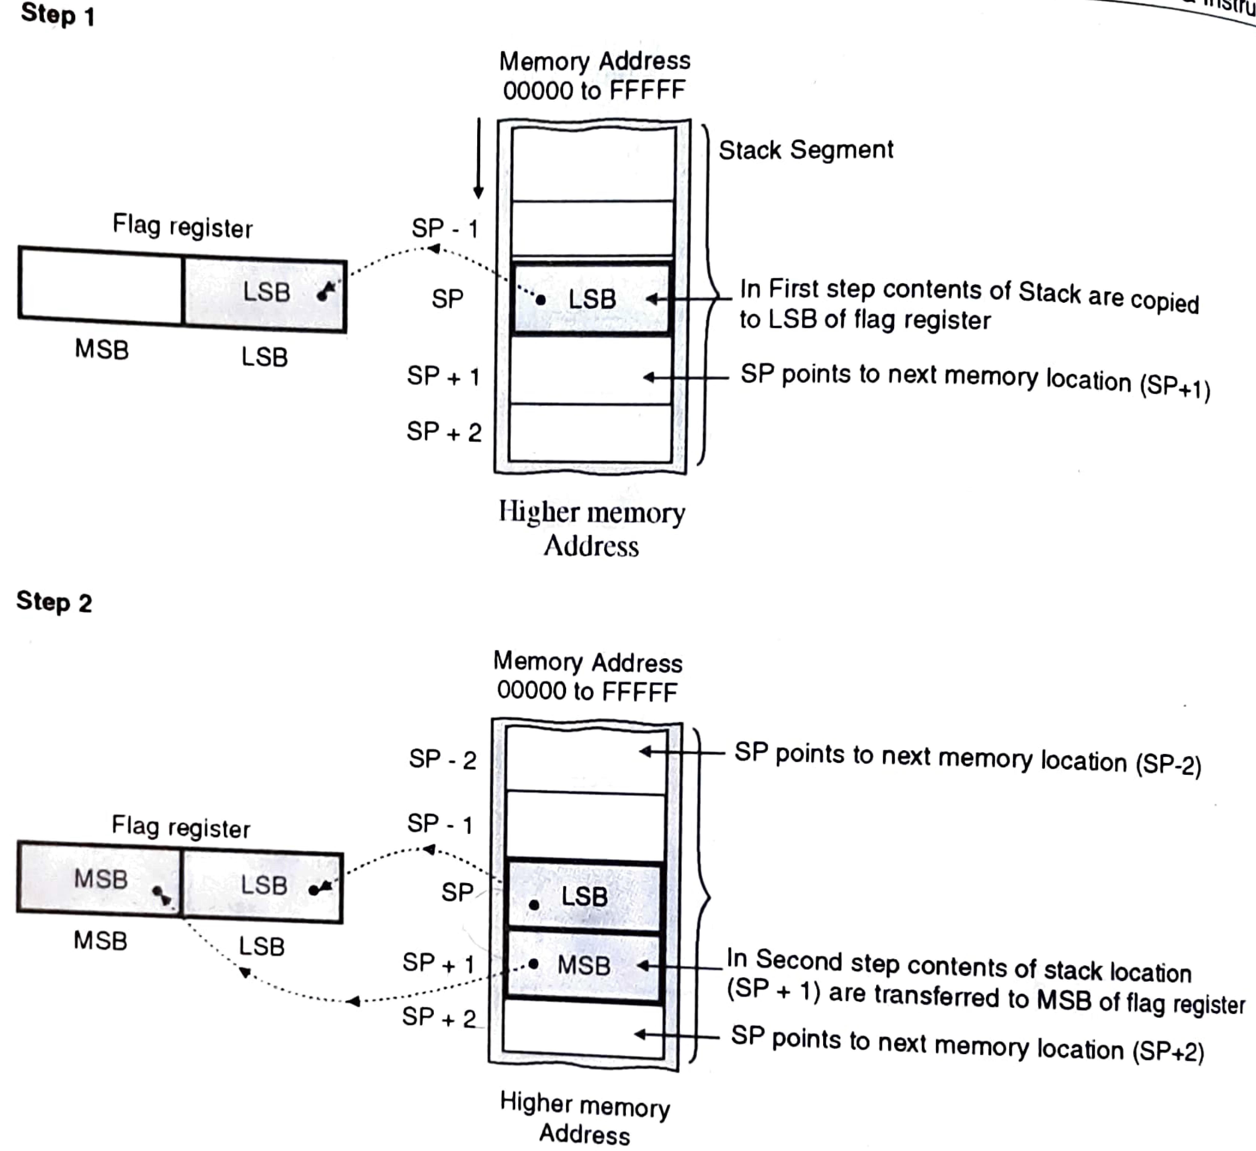
POPF

Slide 42
8086 - Instruction Set
Arithmetic Instructions
Addition
ADD | :Add byte or word
ADC | : Add byte or word with carry
INC | : Increment byte or word by 1
AAA | : ASCII adjust for addition
DAA | : Decimal adjustment for addition

Slide 43
8086 - Instruction Set
Arithmetic Instructions
Subtraction
SUB | :Subtract byte or word
SBB | :Subtract byte or word with borrow
DEC | : Decrement byte or word by1
NEG | : Negate byte or word
CMP | :Compare byte or word
AAS | : ASCII adjust for subtraction
DAS | : Decimal adjustment for subtraction

Slide 44
8086 - Instruction Set
Arithmetic Instructions
Multiplication
MUL | :Multiply byte or word unsigned
IMUL | : Multiply byte or word signed/ Integer Multiply byte or word
AAM | : ASCII adjust for multiply

Slide 45
8086 - Instruction Set
Arithmetic Instructions
Division
DIV | :Divide byte or word unsigned
IDIV | :integer divide byte or word
AAD | : ASCII adjust for division
CBW | : Convert byte to word
CWD | :Convert word to double word

Slide 46
8086 - Instruction Set
Arithmetic Instructions
Addition Instructions
1. ADD Des, Src:
It adds a byte to byte or a word to word.
Adds a number form src to des and the result is in des.
Src: Register ,Memory Location or immediate number.
Des: Register ,Memory Location
Flags affected: AF, CF, OF, PF, SF, ZF
E.g.: ADD AL, 74H
ADD DL, CL
ADD DX, AX
ADD AX, [BX]

Slide 47
8086 - Instruction Set
2) ADC Des, Src:
It adds the two operands with CF.
Src: Register ,Memory Location or immediate number.
Des: Register ,Memory Location
Flags affected: AF, CF, OF, PF, SF, ZF
E.g.: ADC AL, 74H
ADC DX, AX
ADC AX, [BX]

Slide 48
ADD BL, CL: CL = 04H and BL = 07H

Slide 49
8086 - Instruction Set
3. INC Src
It increments the byte or word by one. Or add 1 to specified Src.
Src: Register or Memory location.
Flags affected: AF, OF, PF, SF, ZF
CF is not affected.
E.g.: INC AX
INC BL

Slide 50
8086 - Instruction Set
4. AAA (ASCII Adjust after Addition):
The data entered from the terminal is in ASCII format.
In ASCII, 0 – 9 are represented by 30H – 39H.
This instruction allows us to add the ASCII codes.
It result is obtained in unpacked BCD form.
This instruction does not have any operand.
AAA updates the AF & CF
But OF,PF,SF,ZF are undefined

Slide 51
8086 - Instruction Set
4. AAA (ASCII Adjust after Addition):
AAA instrcution woks only on AL reg
If lower nibble of AL > 9 or AF=1
then AL =AL + 6
AH = AH + 1
AF =1, CF=1 else AF=0, CF=0
Eg: ADD CL ; if AL=34 ASCII & CL= 38 ASCII
AL= 6CH Incorrect
AAA ;AL= 0 2 Unpacked BCD
Carry = 1 Ans= 12 decimal

Slide 52
AL=35 ASCII ==5 5+ 9= 14==E
BL= 39 ASCII ==9
0 0 1 1 0 1 0 1 ➔ AL
+ 0 0 1 1 1 0 0 1 ➔ BL
0 1 1 0 1 1 1 0 ➔ 6E
+ 0 0 0 0 0 1 1 0 ➔ 06
0 0 0 0 0 1 0 0
+ 0 0 0 1 ➔1
0 0 0 1 0 1 0 0 ==14

Slide 53
8086 - Instruction Set
5. DAA (Decimal Adjust after Addition)
It is used to make sure that the result of adding two BCD numbers is adjusted to be a correct BCD number.
It only works on AL register.
Flags updated: AF, CF, PF & ZF. OF is undefined

Slide 54
8086 - Instruction Set
5. DAA (Decimal Adjust after Addition)
If the value of low order 4 bits (D0-D3) in the AL reg is greater than 9 or if AF is set, the instruction adds 06 to the result
If lower nibble of AL > 9 or AF=1
then AL =AL + 6
If the value of higher order 4 bits (D4-D7) in the AL reg is greater than 9 or if CF is set, the instruction adds 60 to the result
If higher nibble of AH > 9 or CF=1
then AH =AH + 6

Slide 55
AL =59 BL =34 ADD AL,BL DAA
ADD AL, BL 0101 1001
+ 0011 0100
1000 1 1 01
8 D
AL = 8DH invalid
DAA 0011 0100
+ 0000 0110
1001 001 1 ➔93
AL = 93H

Slide 56
8086 - Instruction Set
II Substraction Instructions:
6. SUB Des, Src:
It subtracts a byte from byte or a word from word.
Subtracts a number in the src from des and the result is in des.
Src: Register ,Memory Location or immediate number.
Des: Register ,Memory Location
Flags affected: AF, CF, OF, PF, SF, ZF flags.
For subtraction, CF acts as borrow flag.
E.g.: SUB AL, 74H
SUB DX, AX
SUB AX, [BX]

Slide 57
8086 - Instruction Set
7. SBB Des, Src:
It subtracts the two operands and also the borrow from the result.
Src: Register ,Memory Location or immediate number.
Des: Register ,Memory Location
Flags affected: AF, CF, OF, PF, SF, ZF flags.
E.g.: SBB AL, 74H
SBB DX, AX
SBB AX, [BX]

Slide 58
8086 - Instruction Set
8. DEC Src:
It decrements the byte or word by one.
Src: Register or Memory location.
Flags affected: AF, OF, PF, SF, ZF
CF is not affected.
E.g.: DEC AX
DEC BL

Slide 59
8086 - Instruction Set
9. NEG Src:
It creates 2’s complement of a given number and stores it back in the Src.
That means, it changes the sign of a number.
Src: Register, Memory location
Flags affected: AF, OF, PF, SF, ZF, CF
Assume AL= 0011 0101 = 35H then
NEG AL; AL 1100 1011 = CBH

Slide 60
NEG AX
AX = 00A3H = 0000 0000 1010 0011
2’s complement= 1111 1111 0101 1100 ---1’s complement
+ 1
1111 1111 0101 1101 –2’s complement
Contents of AX after Execution on NEG AX
= FF5DH

Slide 61
8086 - Instruction Set
10. CMP Des, Src:
It compares two specified bytes or words.
Src: Immediate numebr, register or memory location.
Des: Register or memory location.
Both operands cannot be a memory location at the same time.
The comparison is done simply by internally subtracting the source from destination.
The value of source and destination does not change, but the flags are modified to indicate the result.
Flags affected: AF, OF, PF, SF, ZF, CF
Eg: CMP BL,55H BL=55 CF ZF SF
CMP CX,BX SRC>DES 1 0 1
CMP AL, [5000H] SRC<DES 0 0 0
SRC=DES 0 1 0

Slide 62
8086 - Instruction Set
11. AAS (ASCII Adjust after Subtraction):
Similar like AAA
It result is obtained in unpacked BCD form.
This instruction does not have any operand.
Flag Affected: AF & CF But OF,PF,SF,ZF are undefined
Let AL = 0011 1001 ➔ 39H ➔ ASCII 9
Let BL = 0011 0101 ➔ 35H ➔ASCII 5
SUB AL, BH =➔ 0011 1001
- 0011 0101
0000 0100 ➔ BCD = 04
CF = 0 No borrow required

Slide 63
8086 - Instruction Set
12. DAS (Decimal Adjust after Subtraction)
It is used to make sure that the result of subtracting two BCD numbers is adjusted to be a correct BCD number.
It only works on AL register.
Flags updated: AF, CF, PF & ZF. OF is undefined
If the value of low order 4 bits (D0-D3) in the AL reg is greater than 9 or if AF is set, the instruction subtracts 06 to the result
If the value of higher order 4 bits (D4-D7) in the AL reg is greater than 9 or if CF is set, the instruction subtracts 60 to the result

Slide 64
AL = 1000 0110 ➔ 86 BCD
BH = 0101 0111 ➔ 57 BCD
SUB AL, BH
DAS
AL = 1000 0110
BH = - 0101 0111
0010 1111 ➔ 2F, CF = 0
Lower Nibble = FH - 0000 0110 ➔ 06
➔ >9 subtract 06 0010 1001 ➔ 29H BCD

Slide 65
8086 - Instruction Set
III Multiplication Instruction
13. MUL Src: (unsigned multiplication ) 8/16 bit
It multiplies two bytes to produce a word or two words to produce a double word. AX = AL * Src (8 bit)
DX : AX = AX * Src (16 bit)
This instruction assumes one of the operand in AL or AX.
Src: register or memory location.
It affects AF,PF,SF & ZF
Eg: MUL BL; AX = AL * BL
MUL BX; DX : AX = AX * BX

Slide 66
8086 - Instruction Set
IV Division
15. DIV Src: (unsigned division ) 8/16 bit reg – divisor
It divides word by byte or double word by word.
If the divisor is 8 bit then dividend is stored in AX, and the result is stored as: AH = remainder AL = quotient
If the divisor is 16 bit then dividend is stored in DX: AX, and the result is stored as: DX = remainder AX = quotient
ALL flags are undefined after DIV instruction
Eg: DIV BL; AX / BL

Slide 67
8086 - Instruction Set
15. IMUL Src: (signed multiplication ) 8/16 bit
17. IDIV Src: (signed division) 8/16 bit

Slide 68
8086 - Instruction Set
V Sign Extension Instruction
11. CBW (Convert signed Byte to signed Word):
This instruction converts byte in AL to word in AX
This instruction copies the sign of the byte in AL to all bits in AH
AH is said to be sign extension of Al or DX is said to be sign extension of AX
Eg: Assume AX = XXXX XXXX 1001 1000
Then CBW gives AX= 1111 1111 1001 0001

Slide 69
8086 - Instruction Set
12. CWD (Convert Word to Double Word):
This instruction converts word in AX to double word in DX : AX.
It copies sign of the word in AX into all the bits of DX.
DX is then called sign extension of AX
The conversion is done by extending the sign bit of AX throughout DX.
Eg: Assume AX = 1000 0000 1001 0001
DX = xxxx xxxx xxxx xxxx
Then CWD gives AX = 1000 0000 1001 0001
DX = 1111 1111 1111 1111

Slide 70
8086 - Instruction Set
Bit Manipulation Instructions:
These instructions are used at the bit level.
These instructions can be used for:
Testing a zero bit
Set or reset a bit
Shift bits across registers

Slide 71
8086 - Instruction Set
Bit Manipulation Instructions
LOGICALS
NOT | :Not byte or word
AND | :And byte or word
OR | : Inclusive or byte or word
XOR | : Exclusive byte or word
TEST | :Test byte or word

Slide 72
8086 - Instruction Set
Bit Manipulation Instructions
SHIFTS
SHL/SAL | : Shift logical/ arithmetic left byte or word
SHR | : Shift logical right byte or word
SAR | : Shift arithmetic right byte or word
ROTATES
ROL | : Rotate left byte or word
ROR | : Rotate right byte or word
RCL | : Rotate through carry left byte or word
RCR | : Rotate through carry right byte or word

Slide 73
8086 - Instruction Set
1. NOT Src:
It complements each bit of Src to produce 1’s complement of the specified operand.
Src: register or memory location.
Eg: NOT AL
NOT CX

Slide 74
8086 - Instruction Set
2. AND Des, Src:
It performs AND operation of Des and Src.
Src: Immediate number, register or memory
location.
Des: register or memory location.
Both operands cannot be memory locations at the same time.
Flags Affected: CF and OF become zero after the operation and PF, SF and ZF are updated. AF is undefined
Eg: AND BL,AL
AND CX, 00F0H

Slide 75
8086 - Instruction Set
3. OR Des, Src:
It performs OR operation of Des and Src.
Src: immediate number, register or memory
location.
Des: register or memory location.
Both operands cannot be memory locations at the same time.
Flags Affected: CF and OF become zero after the operation and PF, SF and ZF are updated. AF is undefined
Eg: OR BL,AL
OR CX, 00F0H

Slide 76
8086 - Instruction Set
4. XOR Des, Src:
It performs XOR operation of Des and Src.
Src: immediate number, register or memory
location.
Des: register or memory location.
Both operands cannot be memory locations at the same time.
Flags Affected: CF and OF become zero after the operation and PF, SF and ZF are updated. AF is undefined
Eg: XOR BL,AL
XOR CX, 00F0H

Slide 77
8086 - Instruction Set
5. TEST des, src
This instruction logically AND’s the source with the destination but the result is not stored anywhere.
Both the Src and Des should be of same size.
Src: immediate number, register or memory location.
Des: register or memory location.
Only flag bits are affected.
Flags are affected, PF, SF and ZF are updated to show results.
Eg: TEST BL,AL
TEST CX, BX

Slide 78
8086 - Instruction Set
Shift Instructions
SAL/SHL Des, Count:
It shift bits of byte or word left, by count
It puts zero(s) in LSBs and MSB is shifted into carry flag.
Des: Register or Memory Location
Bits are shifted ‘count’ no. of types
If count = 1,it is directly specified in the instruction as count
If count > 1, count is put in CL register & CL gives the count in the instruction.

Slide 79
8086 - Instruction Set
Eg: Count = 1 ;SAL BL,1
Assume before operation BL=0011 0011 & CF=1
Carry Destination
After operation BL=0110 0110 & CF=0
Carry Destination
Eg: Count >1
MOV CL, 05H
SAL BL,CL
1 |  |  | 0 MSB | 0 | 1 | 1 | 0 | 0 | 1 | 1 LSB |  | 0
0 |  |  | 0 | 1 | 1 | 0 | 0 | 1 | 1 | 0

Slide 80
8086 - Instruction Set
SHR Des, Count:
It shift bits of byte or word right, by count
It puts zero(s) in MSBs and LSB is shifted into carry flag.
Des: Register or Memory Location
Bits are shifted ‘count’ no. of types
If count = 1,it is directly specified in the instruction as count
If count > 1, count is put in CL register & CL gives the count in the instruction.

Slide 81
8086 - Instruction Set
Eg: Count = 1 ;SHR BL,1
Assume before operation BL=0011 0011 & CF=0
Destination Carry
After operation BL=0001 1001 & CF=1
Destination Carry
Eg: Count >1
MOV CL, 05H
SHR BL,CL
0 |  |  | 0 MSB | 0 | 1 | 1 | 0 | 0 | 1 | 1 LSB |  |  | 0
 |  |  | 0 | 0 | 1 | 1 | 0 | 0 | 1 | 1 |  |  | 1

Slide 82
8086 - Instruction Set
SAR Des, Count:
It right shifts bits of destination byte or word right, by count
A copy of old MSB is placed in MSB itself and LSB is shifted into carry flag.
Des: Register or Memory Location
Bits are shifted ‘count’ no. of types
If count = 1,it is directly specified in the instruction as count
If count > 1, count is put in CL register & CL gives the count in the instruction.

Slide 83
8086 - Instruction Set
Eg: Count = 1 ;SHR BL,1
Assume before operation BL=0011 0011 & CF=0
Destination Carry
After operation BL=0001 1001 & CF=1
Destination Carry
Eg: Count >1
MOV CL, 05H
SHR BL,CL
 |  |  | 0 | 0 | 1 | 1 | 0 | 0 | 1 | 1 |  |  | 0
 |  |  | 0 | 0 | 0 | 1 | 1 | 0 | 0 | 1 |  |  | 1

Slide 84
8086 - Instruction Set
Rotate Instructions
ROL Des, Count
The instruction rotates all bits of destination byte or word to the left, by count
MSB is shifted into carry flag and also goes to LSB
Des: Register or Memory Location
Bits are shifted ‘count’ no. of types
If count = 1,it is directly specified in the instruction as count
If count > 1, count is put in CL register & CL gives the count in the instruction.

Slide 85
8086 - Instruction Set
Eg: Count = 1 ;ROL BL,1
Assume before operation BL=0011 0011 & CF=1
Carry Destination
After operation BL=0110 0110 & CF=0
Carry Destination
Eg: Count >1
MOV CL, 05H
ROL BL,CL
CY |  |  | D7 | D6 | D5 | D4 | D3 | D2 | D1 | D0
1 |  |  | 0 | 0 | 1 | 1 | 0 | 0 | 1 | 1
0 |  |  | 0 | 1 | 1 | 0 | 0 | 1 | 1 | 0

Slide 86
8086 - Instruction Set
2. ROR Des, Count:
The instruction rotates all bits of destination byte or word right, by count
LSB is shifted into carry flag and also goes to MSB
Des: Register or Memory Location
Bits are shifted ‘count’ no. of types
If count = 1,it is directly specified in the instruction as count
If count > 1, count is put in CL register & CL gives the count in the instruction.

Slide 87
8086 - Instruction Set
Eg: Count = 1 ;ROR BL,1
Assume before operation BL=0011 0011 & CF=0
Carry Destination
After operation BL=0001 1001 & CF=1
Carry Destination
Eg: Count >1
MOV CL, 05H
ROR BL,CL
CY |  |  | D7 | D6 | D5 | D4 | D3 | D2 | D1 | D0
0 |  |  | 0 | 0 | 1 | 1 | 0 | 0 | 1 | 1
1 |  |  | 1 | 0 | 0 | 1 | 1 | 0 | 0 | 1

Slide 88
8086 - Instruction Set
3.RCL Des, Count
The instruction rotates all bits of destination byte or word to the left, by count
MSB is shifted into carry flag (CF) and CF goes to LSB
Des: Register or Memory Location
Bits are shifted ‘count’ no. of types
If count = 1,it is directly specified in the instruction as count
If count > 1, count is put in CL register & CL gives the count in the instruction.

Slide 89
8086 - Instruction Set
Eg: Count = 1 ;RCL BL,1
Assume before operation BL=0011 0011 & CF=1
Carry Destination
After operation BL=0110 0110 & CF=0
Carry Destination
Eg: Count >1
MOV CL, 05H
RCL BL,CL
CY |  |  | D7 | D6 | D5 | D4 | D3 | D2 | D1 | D0
1 |  |  | 0 | 0 | 1 | 1 | 0 | 0 | 1 | 1
0 |  |  | 0 | 1 | 1 | 0 | 0 | 1 | 1 | 1

Slide 90
8086 - Instruction Set
4. RCR Des, Count:
The instruction rotates all bits of destination byte or word right, by count
LSB is shifted into carry flag and CF goes to MSB
Des: Register or Memory Location
Bits are shifted ‘count’ no. of types
If count = 1,it is directly specified in the instruction as count
If count > 1, count is put in CL register & CL gives the count in the instruction.

Slide 91
8086 - Instruction Set
Eg: Count = 1 ;RCR BL,1
Assume before operation BL=0011 0011 & CF=0
Carry Destination
After operation BL=0001 1001 & CF=1
Carry Destination
Eg: Count >1
MOV CL, 05H
RCR BL,CL
CY |  |  | D7 | D6 | D5 | D4 | D3 | D2 | D1 | D0
0 |  |  | 0 | 0 | 1 | 1 | 0 | 0 | 1 | 1
1 |  |  | 0 | 0 | 0 | 1 | 1 | 0 | 0 | 1

Slide 92
8086 - Instruction Set
Processor Control Instructions
These instructions control the processor itself.
8086 allows to control certain control flags that:
Causes the processing in a certain direction
Processor synchronization if more than one microprocessor attached.

Slide 93
8086 - Instruction Set
Processor Control Instructions
FLAG OPERATIONS
STC | : Set carry flag
CLC | : Clear carry flag
CMC | : Complement carry flag
STD | : Set Direction Flag
CLD | : Clear direction flag
STI | : Set Interrupt enable flag
CLI | : Clear interrupt enable flag

Slide 94
8086 - Instruction Set
Processor Control Instructions
NO OPERATION
NOP | : No Opeartion
EXTERNAL SYNCHRONIZATION
HLT | : Halt until interrupt or reset
WAIT | : Wait for TEST pin active
ESC | : Escape to external coprocessor
LOCK | : Lock bus during next instruction

Slide 95
8086 - Instruction Set
Processor Control Instructions
1. For Carry Flag:
STC:
This instruction sets the carry flag to 1.
CLC:
This instruction clears the carry flag to 0.
CMC:
This instruction complements the carry flag.
NO OTHER FLAGS ARE AFFECTED

Slide 96
8086 - Instruction Set
Processor Control Instructions
2. For Direction Flag:
STD:
This instruction sets the direction flag to 1.
CLD:
This instruction clears the direction flag to 0.
NO OTHER FLAGS ARE AFFECTED

Slide 97
8086 - Instruction Set
Processor Control Instructions
2. For Interrupt Enable Flag:
STI:
This instruction sets the Interrupt Enable flag to 1.
CLI:
This instruction clears the Interrupt Enable flag to 0.
NO OTHER FLAGS ARE AFFECTED

Slide 98
8086 - Instruction Set
External Hardware Synchronization Instructions
ESC
Instruction – prefix used to indicate that the current instruction is for the 8087 NDP.
When an instruction with ESC prefix is encountered, 8087 is activated and hence it executes the instruction.

Slide 99
8086 - Instruction Set
External Hardware Synchronization Instructions
WAIT
Instruction is used to synchronize 8086 with 8087 Co-Processor via TEST input pin of 8086.
This instruction makes the µP check the TEST pin.

Slide 100
8086 - Instruction Set
External Hardware Synchronization Instructions
LOCK
This is 8086 instruction – prefix
It prevents any external bus master from taking control of the system bus during execution of the instruction, which has a LOCK prefix.
It causes 8086 to activate the LOCK signal so that no other bus master takes control of the system bus.

Slide 101
8086 - Instruction Set
External Hardware Synchronization Instructions
NOP
No operation is performed
Requires 3 Tstates
Used toinsert time delays
HLT
Causes 8086 to stop fetching any more instructions.
8086 enters Halt State.

Slide 102
8086 - Instruction Set
Program Execution Transfer Instructions
These instructions cause change in the sequence of the execution of instruction or cause a branch in the program sequence.
Unconditional Call
JMP – Conditional & Unconditional
INT – Software Interrupt

Slide 103
8086 - Instruction Set
Program Execution Transfer Instructions
This change can be through a condition or sometimes unconditional.
The conditions are represented by flags.
There are 2 main types of branching:
Near Branch
Far Branch

Slide 104
8086 - Instruction Set
Program Execution Transfer Instructions
Near Branch
This is a Intra- Segment branch
Needs only IP to be changed
If the Near branch is in the range of –128 to 128, it is called as short jump
Far Branch
This is a Inter- Segment branch
∴ both CS & IP needs to be changed

Slide 105
8086 - Instruction Set
Program Execution Transfer Instructions
The way of calculating the branch address provides us 4 addressing modes for indicating branch addresses
Intrasegment Direct
Intrasegment Indirect
Intersegment Direct
Intersegment Indirect

Slide 106
8086 - Addressing modes for Program Memory
Intra-segment direct mode:
The address to where the control is transferred is specified directly in the instruction as an immediate displacement value.
The address to which the control is to be transferred lies in the same segment in which the control transfer instruction lies

Slide 107
8086 - Addressing modes for Program Memory
Intra-segment direct mode:
Only IP changes, CS does not change
The effective address to which the control will be transferred is given by the sum of 8 or 16 bit displacement and current content of IP.
Eg: JMP Label1

Slide 108
8086 - Addressing modes for Program Memory
2. Intra-segment indirect mode:
The branch address is specified in a register or a memory location (in DS only)
As intra seg only IP changes, CS does not change
Eg: JMP Label1 [BX]
IP {DS:[BX], DS:[BX+1]}

Slide 109
8086 - Addressing modes for Program Memory
3. Inter-segment direct mode:
The new branch address is specified in the instruction.
In this mode, the address to which the control is to be transferred is in a different segment.
This addressing mode provides a means of branching from one code segment to another code segment.

Slide 110
8086 - Addressing modes for Program Memory
3. Inter-segment direct mode:
CS and IP of the destination address are specified directly in the instruction.
Eg: JMP Label
IP offset address of Label
CS Segment address of Label

Slide 111
8086 - Instruction Set
1. JMP Des (Unconditional Jump):
Intra Segment (Near) Jump:
Jump address specified in two ways:
Intra Segment Direct Jump: Relative Jump
Intra Segment Indirect Jump

Slide 112
8086 - Instruction Set
JMP Des (Unconditional Jump):
Intra Segment (Near) Jump:
Intra Segment Direct Jump: Relative Jump
The new branch location is specified directly in the instruction.
The new addr is calculated by adding 8/16 bit displacement to IP.
CS does not change
Eg: JMP Prev; JMP Next

Slide 113
8086 - Instruction Set
JMP Des (Unconditional Jump):
Intra Segment (Near) Jump:
Intra Segment Direct Jump: Relative Jump
A +ve displacement means that the JUMP is ahead (forward) of the program
A -ve displacement means that the JUMP is behind (backward) of the program

Slide 114
8086 - Instruction Set
Intra Segment (Near) Jump
Intra Segment Indirect Jump:
The new branch location is specified indirectly through a register or a memory location (in DS only).
The value in IP is replaced with a new value.
CS does not change
Eg: JMP WORD PTR [BX]; IP {DS:[BX], DS:[BX+1]}

Slide 115
8086 - Instruction Set
Inter Segment (Far) Jump
Jump address specified in two ways:
Intra Segment Direct Jump:
Intra Segment Indirect Jump:

Slide 116
8086 - Instruction Set
Inter Segment (Far) Jump
Jump address specified in two ways:
Intra Segment Direct Jump:
The new branch location is specified directly in the instruction.
Both IP and CS gets new values.
Eg: Assume NextSeg; Label pointing to an instruction in a different segment.
JMP NextSeg;

Slide 117
8086 - Instruction Set
Inter Segment (Far) Jump
Intra Segment Indirect Jump:
The new branch location is specified indirectly through a register or a memory location (in DS only).
Both IP and CS gets new values.
Eg: JMP DWORD PTR [BX];
IP {DS:[BX], DS:[BX+1]}, CS {DS:[BX+2], DS:[BX+3]}

Slide 118
8086 - Instruction Set
2. JCondition Des (Conditional Jump):
This is a conditional branch instruction.
All the conditional jumps follow some conditional statements or any instruction that affects the flag.
Sr. No. | DESCRIPTION | Jump Condition
1. | Carry | CF =1
2. | Not Carry | CF = 0
3. | Equal or Zero | ZF = 1
4. | Not Equal or Not Zero | ZF = 0
5. | Parity or Even Parity | PF = 1
6. | Not Parity or Odd Parity | PF = 0

Slide 119
8086 - Instruction Set
JCondition Des (Conditional Jump):
If the condition is TRUE,then it is similar to an INTRA- Segment Direct Jump.
If the condition is FALSE, then the branch does not take place and the next sequential instruction is executed.
The destination must be in the range of –128 to 128 from the address of the instruction (ie only SHORT Jump)
Eg: JNC Next

Slide 120
8086 - Instruction Set
Conditional Jump Table
Sr. No. | Mnemonic | DESCRIPTION | Jump Condition
COMMON OPERATIONS
1. | JC | Carry | CF =1
2. | JNC | Not Carry | CF = 0
3. | JE/JZ | Equal or Zero | ZF = 1
4. | JNE/JNZ | Not Equal or Not Zero | ZF = 0
5. | JP/JPE | Parity or Even Parity | PF = 1
6. | JNP/JPO | Not Parity or Odd Parity | PF = 0

Slide 121
8086 - Instruction Set
Conditional Jump Table
Sr. No. | Mnemonic |  | Meaning | Jump Condition
SIGNED OPEARTIONS
7. | JO | Overflow |  | OF = 1
8. | JNO | Not Overflow |  | OF = 0
9. | JS | Sign |  | SF = 1
10. | JNS | Not Sign |  | SF = 0
11. | JL/JNGE | Less |  | (SF ExOr OF) = 1
12. | JGE/JNL | Greater or Equal |  | (SF ExOr OF) = 0
13. | JLE/JNG | Less or Equal |  | ((SF ExOr OF) + ZF) = 1
14. | JG/JNLE | Greater |  | ((SF ExOr OF) + ZF) = 0

Slide 122
8086 - Instruction Set
Conditional Jump Table
Sr. No. | Mnemonic | Meaning | Jump Condition
UNSIGNED OPERATIONS
15. | JB/JNAE | Below | CF = 1
16. | JAE/JNB | Above or Equal | CF = 0
17. | JBE/JNA | Below or Equal | (SF ExOr ZF) = 1
18. | JA/JNBE | Above | (SF ExOr OF) = 0

Slide 123
8086 - Instruction Set
3. CALL Des: Unconditional Call
This instruction is used to call a subroutine or function or procedure with intention of coming back to the main program.
8086 saves the address of the next instruction after CALL onto stack before branching to the subroutine
Two types of Call: i) Near CALL
ii) Far CALL

Slide 124
8086 - Instruction Set
Intra Segment (Near) CALL
The new subroutine called must be in the same segment (hence intra - segment)
The CALL address: Specified directly in the instruction or through registers or memory location
Sequence executed for a Near CALL
8086 will PUSH Current IP into the Stack.
Decrement SP by 2
New Value loaded into IP
Control transferred to a subroutine within the same segment.
Eg: CALL subADD ;{SS:[SP-1], SS::[SP-2]} IP,
; SP SP-2
; IP New Offset Address of subAdd

Slide 125
8086 - Instruction Set
Intra Segment (Near) CALL
Sequence executed for a Near CALL
8086 will PUSH Current IP into the Stack.
Decrement SP by 2
New Value loaded into IP
Control transferred to a subroutine within the same segment.
Eg: CALL subADD ;{SS:[SP-1], SS::[SP-2]} IP,
; SP SP-2
; IP New Offset Address of subAdd

Slide 126
8086 - Instruction Set
Intra Segment (Far) CALL
The new subroutine called is in another segment (hence inter - segment)
CS & IP both get new values
The CALL address: Specified directly in the instruction or through registers or memory location

Slide 127
8086 - Instruction Set
Intra Segment (Far) CALL
Sequence executed for a Far CALL Eg: CALL subADD
PUSH CS into the Stack. ;{SS:[SP-1], SS::[SP-2]} CS ,
Decrement SP by 2 ; SP SP-2
PUSH Current IP into the Stack. ;{SS:[SP-1], SS::[SP-2]} IP,
Load CS with new segment address; CS New Offset Address of subAdd
Load IP with new segment address ; IP New Offset Address of subAdd
Control transferred to a subroutine in the new segment

Slide 128
8086 - Instruction Set
4. RET:
Causes the control to return to the main program from subroutine
Every CALL instruction should have a RET
Intrasegment RET
Eg: RET ;IP SS:[SP], SS::[SP+1]
;SP SP+2
Intersegment RET
Eg: RET ;IP SS:[SP], SS::[SP+1]
;CS SS:[SP+2], SS::[SP+3]
;SP SP+4

Slide 129
8086 - Instruction Set
Iteration Control Instructions
These instructions cause a series of instructions to be executed repeatedly
The no.of iterations is loaded in CX reg.
CX is decremented by 1, after every iteration
Iterations occur until CX = 0
The max difference between the address of the instruction and the address of the Jump can be 127.

Slide 130
8086 - Instruction Set
Iteration Control Instructions
LOOP Label:
This instructionis used to repeat a series of instructions CX no of times.
Jump to specified label if CX not equal to 0; and decrement CX
Eg: MOV CX,40H
BACK: MOV AL,BL
ADD AL, BL
“
“
“
MOV BL, AL
LOOP BACK; Repeat from the instruction having
BACK label if CX not equal to 0
; CX CX-1

Slide 131
8086 - Instruction Set
Iteration Control Instructions
LOOPE/LOOPZ Label (Loop on Equal/ Loop on Zero)
Jump to specified label if CX not equal to 0 & only if ZF = 1; and decrement CX
Eg: MOV CX,40H
BACK: MOV AL,BL
ADD AL, BL
“
“
“
MOV BL, AL
LOOPZ BACK; Repeat from the instruction having BACK
label if CX not equal to 0 & ZF = 1
; CX CX-1

Slide 132
8086 - Instruction Set
Iteration Control Instructions
LOOPNE/LOOPNZ Label (Loop on NOT Equal/ Loop on NO Zero)
Jump to specified label if CX not equal to 0 & only if ZF = 0; and decrement CX
Eg: MOV CX,40H
BACK: MOV AL,BL
ADD AL, BL
“
“
“
MOV BL, AL
LOOPNZ BACK; Repeat from the instruction having BACK label if CX not equal to 0 & ZF = 1
; CX CX-1

Slide 133
8086 - Instruction Set
Interrupt Control Instructions
1. INT Type
This instruction causes an interrupt of the given type.
Causes 8086 to CALL a far procedure
The “Type” is a no between 0 ……255
Software interrupts
Address of the procedure is taken from memory (IVT Table) whose address is 4* Type no

Slide 134
8086 - Instruction Set
Interrupt Control Instructions
INT Type
Following action takes place
PUSH Flag Register onto the Stack & SP decremented by 2
IF &TF cleared
PUSH CS onto the Stack & SP decremented by 2
PUSH IP onto the Stack & SP decremented by 2
New value of IP taken from location type x4
New value of CS taken from location (type x4) + 2
Execution of the ISR begins from the address formed by the new values of CS & IP
Eg: INT 1 ;IP = {[00004] & [00005]}; CS = {[00006] & [00007]};
as 1x4=00004H

Slide 135
8086 - Instruction Set
Interrupt Control Instructions
2. INTO (Interrupt on Overflow)
This instruction causes an interrupt type 4, only if Overflow Flag (OF) is set
Same action takes place and ctrl transferred to location pointed by 00010H

Slide 136
8086 - Instruction Set
Interrupt Control Instructions
IRET (Return from ISR)
This instruction causes 8086 to return to the main program.
Used at the end of the ISR
The following action takes place
POP IP from the stack: SP incremented by 2
POP CS from the stack: SP incremented by 2
POP Flag Register from the stack: SP incremented by 2.
In all SP incremented by 6
Execution of the Main Program continues from the address formed by CS & IP

Slide 137
8086 - Instruction Set
String Instructions
String is a series of bytes stored sequentially in the memory location.
String instructions operate on strings.
By using these string instructions, the size of the program is considerably reduced.

Slide 138
8086 - Instruction Set
String Instructions
The Source element is taken from Data Segment using the SI register.
The Desitination element is in Extra Segment pointed by the DI register.
SI &/or DI are incremented /decremented after each operation depending upon the direction flag “DF” in Flag Register

Slide 139
8086 - Instruction Set
String Instructions
MOVS: MOVSB/MOVSW (Move String)
Used to transfer a word/byte from data segment to extra segment
Offset : source is in SI and destination is in DI
SI &/or DI are incremented /decremented after each operation depending upon the direction flag “DF” in Flag Register
Eg: MOVSB ; ES:[DI] DS:[SI]
; SI SI ± 1 & DI DI ± 1: depending on DF
MOVSW ;{ES:[DI], ES:[DI+1]} DS:[SI], DS:[SI+1]
; SI SI ± 2 & DI DI ± 2: depending on DF

Slide 140
8086 - Instruction Set
String Instructions
2. LODS: LODSB/LODSW (Load String)
Load AL or AX Reg with a byte or word from data segment
Offset of the source is in SI
SI is incremented /decremented after each operation depending upon the direction flag “DF” in Flag Register
Eg: LODSB ; AL DS:[SI]
; SI SI ± 1 : depending on DF
LODSW ;AL DS:[SI], AH DS:[SI+1]
; SI SI ± 2 : depending on DF

Slide 141
8086 - Instruction Set
String Instructions
3. STOS: STOSB/ STOSW (Store String)
Store AL or AX Iinto a byte or word in Extra segment
Offset of the source in Extra Segemnt is in DI
DI is incremented /decremented after each operation depending upon the direction flag “DF” in Flag Register
Eg: STOSB, STOSW

Slide 142
8086 - Instruction Set
String Instructions
4. CMPS: CMPSB/ CMPSW (Compare String)
Compare a byte or word in the Data Segment with a byte or word in the Extra Segemnt
Offset of the byte or word in Data Segment is in SI
Offset of the byte or word in Extra Segemnt is in DI
SI &/or DI is incremented /decremented after each operation depending upon thedirection flag “DF” in Flag Register
Comparision done by substraction ([ES] – [DS]), result not stored; flag bits affected
Eg: CMPSB, CMPSW

Slide 143
8086 - Instruction Set
String Instructions
5. SCAS: SCASB/ SCASW (String Compare Accumulator)
Compare the contents of AL or AX with a byte or word in the Extra Segemnt
Offset of the byte or word in Extra Segemnt is in DI
DI is incremented /decremented after each operation depending upon the direction flag “DF” in Flag Register
Comparision done by substracting byte or word from AL or AX; result not stored; flag bits affected
Eg: SCASB, SCASW

Slide 144
8086 - Instruction Set
String Instructions
6. REP(Repeat)
Instruction – prefix used in string instructions
Canbe used only with string instructions
Causes the instruction to be repeated CX number of times
After every execution, SI and DI reg are incremented /decremented after each operation depending upon thedirection flag “DF” in Flag Register and CX is decremented

Slide 145
8086 - Instruction Set
String Instructions
7. REPZ/REPE (Repeat on ZERO/ Equal)
Conditional repeat Instruction – prefix
Causes the instruction to be repeated CX number of times till ZF = 1
8. REPNZ/REPNE (Repeat on No ZERO/ Equal)
Conditional repeat Instruction – prefix
Causes the instruction to be repeated CX number of times till ZF = 0

Slide 146
8086 - Assembler Directives
Thank You

Slide 147
8086 - Instruction Set
Intra Segment (Far) CALL
The new subroutine called is in another segment (hence inter - segment)
CS & IP both get new values
The CALL address: Specified directly in the instruction or through registers or memory location
Sequence executed for a Far CALL Eg: CALL subADD
PUSH CS into the Stack. ;{SS:[SP-1], SS::[SP-2]} CS ,
Decrement SP by 2 ; SP SP-2
PUSH Current IP into the Stack. ;{SS:[SP-1], SS::[SP-2]} IP,
Decrement SP by 2 ; SP SP-2
Load CS with new segment address ; CS New Offset Address of subAdd
Load IP with new segment address ; IP New Offset Address of subAdd
Control transferred to a subroutine in the new segment.

